Slide 1


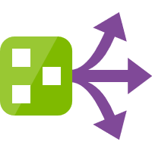
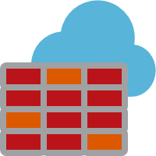







Azure Network – Firewall & Service Endpoint
Spoke VNet - App
Hub VNet - Firewall
VNet – 10.1.0.0/16
VNet – 10.0.0.0/16
Route Filters
Subnet – 10.1.0.0/24
Ext traffic routed to Azure Firewall
Subnet – 10.0.0.0/24
AzureFirewallSubnet
Route Table
Deny all traffic by default
VNet Peering
Traffic filtering rules allow outbound access to key vault
Key Vault
VM
Azure Firewall
20.38.149.196
10.1.0.4
Traffic goes through Microsoft backbone
network
NIC
10.1.0.4
10.0.0.4
1. Outbound key vault allowed
2. Outbound internet denied
Service Endpoint
NSG
Integrated with Azure Monitor for logging & analyzing traffic
Export logs for monitoring & alerting
Log analytics workspace
Comments
Service Endpoint enabled only for AzureFirewallSubnet
Connects to Public IP through Azure backbone network
Source IP is switched to Private
No VNet peering in case of CDP

Slide 2
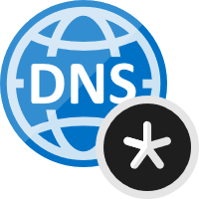


Azure Network - Firewall, Private Endpoint & Service Endpoint
Spoke VNet - App
Spoke VNet – Private Endpoint
VNet – 10.1.0.0/16
VNet – 10.2.0.0/16
Route Filters
Subnet – 10.1.0.0/24
10.0.0.4 → 10.2.0.16
privatelink.vaultcore.azure.net
Subnet – 10.2.0.0/24
Route Table
VNet Link
Auto-registered
VNet Link
Auto-registered
Private Link
NIC with Private IP from the Subnet is created & assigned to Key Vault
VM
Private Endpoint NIC
Key Vault
Azure DNS private zone Key Vault
20.38.149.196
10.1.0.4
10.2.0.4
10.1.0.4
NIC
NIC
NIC
VNet Link
Auto-registered
Hub VNet - Firewall
VNet – 10.0.0.0/16
Subnet – 10.0.0.0/24
AzureFirewallSubnet
VNet Peering
VNet Peering
Azure Firewall
10.0.0.4
Log analytics workspace
Service Endpoint

Slide 3
Before Private Link (External & Internal Name Resolution)
HOST: kv-pep-spokepep.vault.azure.net
IP: 20.38.149.196
Key Vault Name:
kv-pep-spokepep.vault.azure.net
After Private Link (External Name Resolution)
CNAME: kv-pep-spokepep.privatelink.vaultcore.azure.net
HOST: kv-pep-spokepep.vault.azure.net
IP: 20.38.149.196
After Private Link (Internal Name Resolution)
HOST: kv-pep-spokepep.privatelink.vaultcore.azure.net
IP: 10.2.0.4

Slide 4
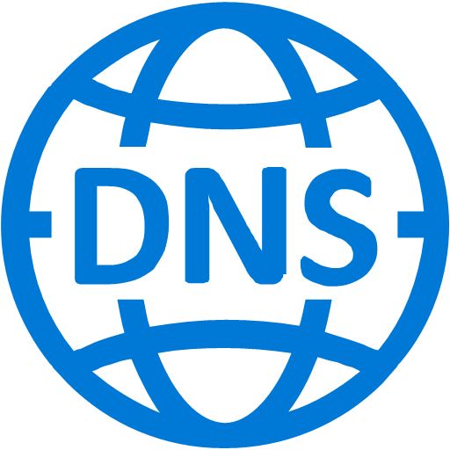

Azure Network - Firewall, DNS, Private Endpoint
Authoritative DNS for vault.azure.net
Received Query: kv-pep-spokepep.vault.azure.net
Response: kv-pep-spokepep.privatelink.vaultcore.azure.net (CNAME)
Azure Private DNS Zone
privatelink.vaultcore.azure.net
4
Received Query: kv-pep-spokepep.privatelink.vaultcore.azure.net
Response: 10.2.0.4
3
2
VNet link
VNet link
VNet link
5
Azure Provided DNS
168.63.129.16
Azure Provided DNS
168.63.129.16
Spoke VNet - App
Azure Provided DNS
168.63.129.16
Hub VNet - Firewall
Spoke VNet – Private Endpoint
VNet – 10.1.0.0/16
VNet – 10.0.0.0/16
VNet – 10.2.0.0/16
Subnet – 10.1.0.0/24
6
Subnet – 10.0.0.0/24
AzureFirewallSubnet
Subnet – 10.2.0.0/24
1
Deny all traffic by default
8
Private Link
VNet Peering
VNet Peering
NIC with Private IP from the Subnet is created & assigned to Key Vault
VM
7
Traffic filtering rules allow inbound/outbound access
Private Endpoint NIC
Key Vault
NIC
10.1.0.4
Route Filters
Azure Firewall
20.38.149.196
10.0.0.4 → 10.2.0.16
10.0.0.4
10.2.0.4
NSG
NIC
1. Outbound key vault allowed
2. Outbound internet denied
Route Table
Integrated with Azure Monitor for logging & analyzing traffic
Log analytics workspace

